Slide 1
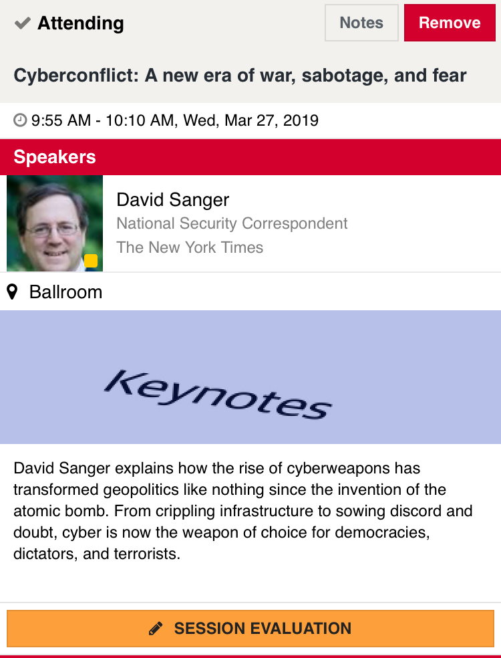
Rate today ’s session
Session page on conference website
O’Reilly Events App

